Slide 1
Group CW2003
Final Year Project Presentation
Student Name:
Fung Ka Wai
Wong King Hong
Cen WeiCheng
Cheng Chun Hei

Slide 2
1.Background
2.Problem Background
TABLE OF
CONTENTS
3.Project Objective
4.Planning
5.Function
6.Diagram

Slide 3

COVID-19
Smart District Development
Background

Slide 4

Problem Background
We have the following problems:
Cash Payment
Cash is one of the indirect transmissions of infectious disease.
No online platform provides local markets selling goods.
Business Slump
Merchants may want to operate by using online payment methods to attract customers and increase revenue.
Some people may want to buy fresh food from the local market and their favorite shop instead of the supermarket.

Slide 5



Project Objective
We need to :
Cashless transaction
Delivery
Time-saving

Slide 6
Completed Work (Functions Provided)
Good List
Searching Filter
Upload Product
Coupon
Order Record
Account Management
Online Platform (Website):
Registration
Login
Edit profile
Shopping Cart
Stall Management
Set Promotion

Slide 7
Control Panel - Function

Slide 8
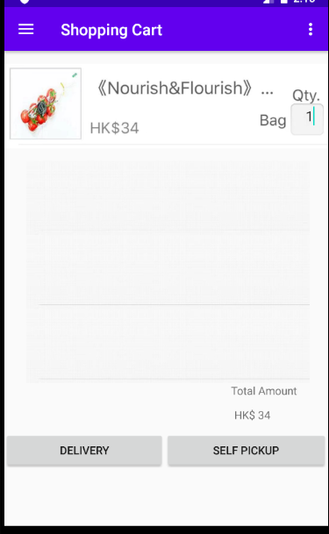
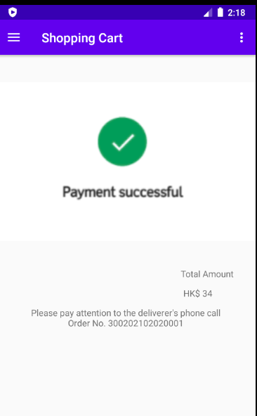
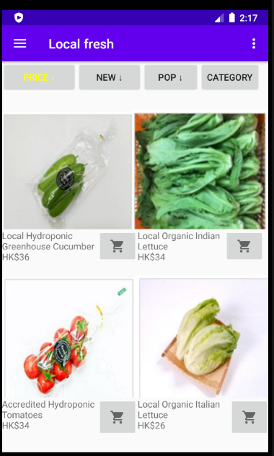
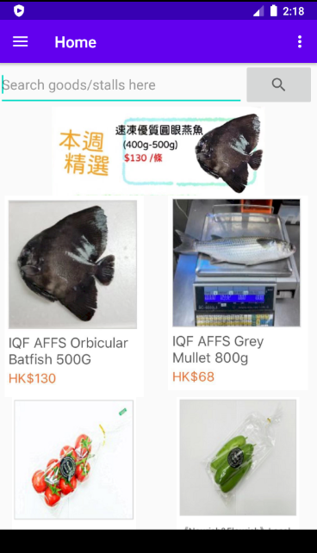

Expected Upcoming Progression
Mobile Device (Application):
1
Search goods or stalls
2
Browse goods (sort by some order)
3
Shopping Cart
4
Purchasing By External Payment Gateway

Slide 9




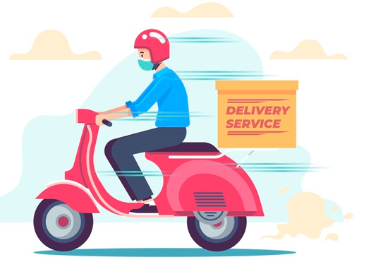



Normal user workflow
Search goods
Add to shopping cart
Choose a payment method
Choose a pickup method
Delivery
Yes
Delivery?
No
Walk-In
Place Order
Checkout

Slide 10
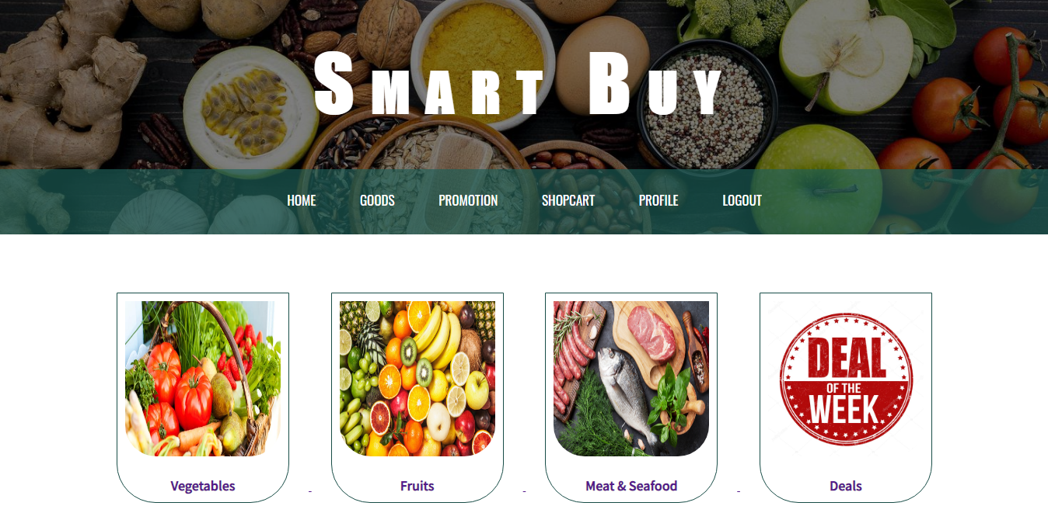
Website (Main Menu)

Slide 11
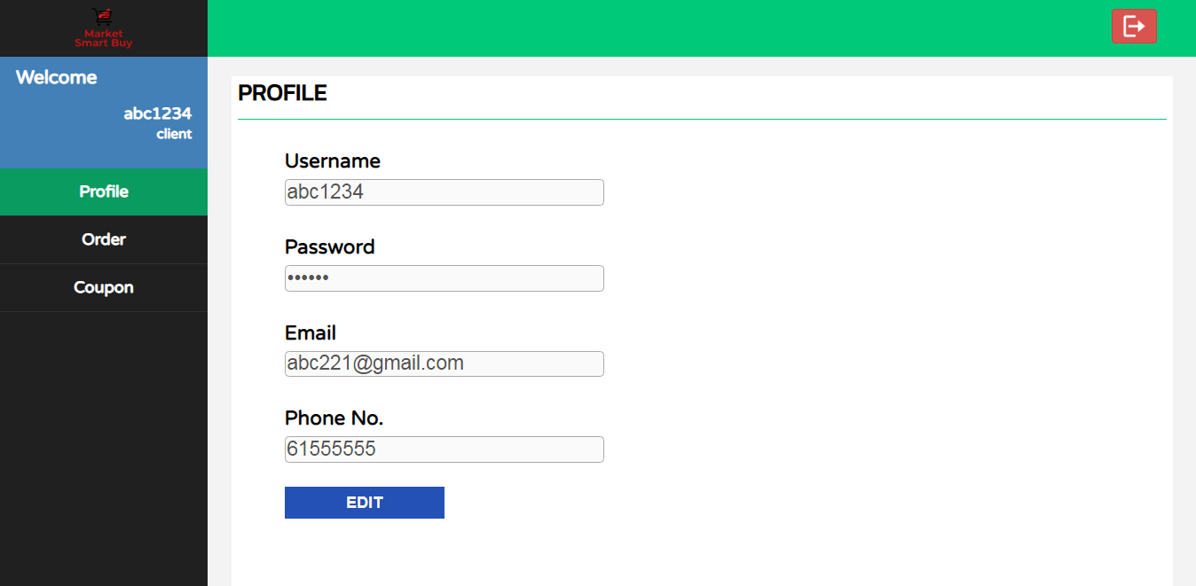
Website (Dashboard)

Slide 12
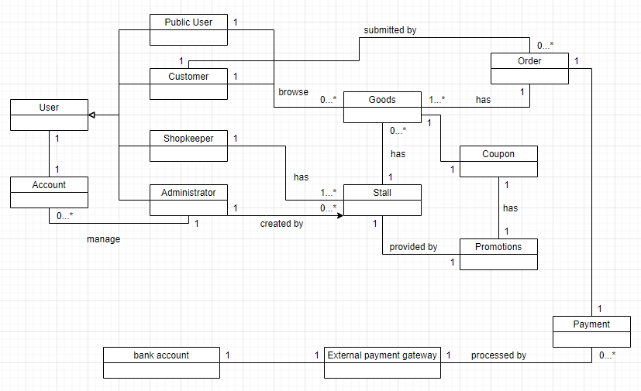
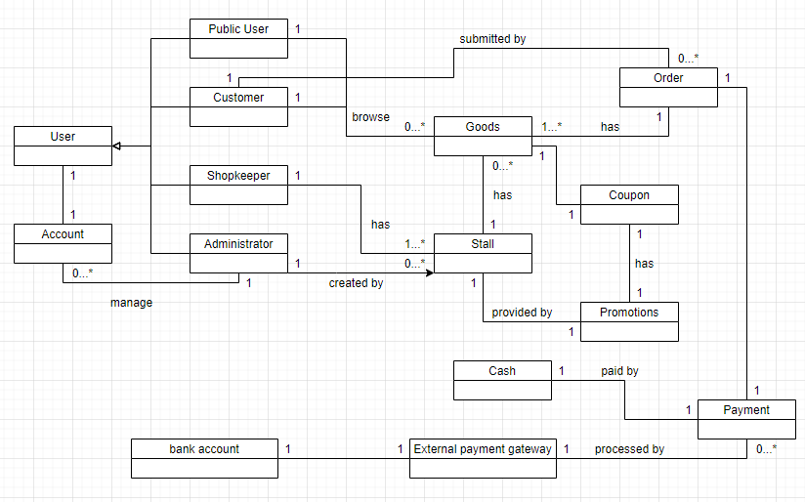
Class diagram

Slide 13
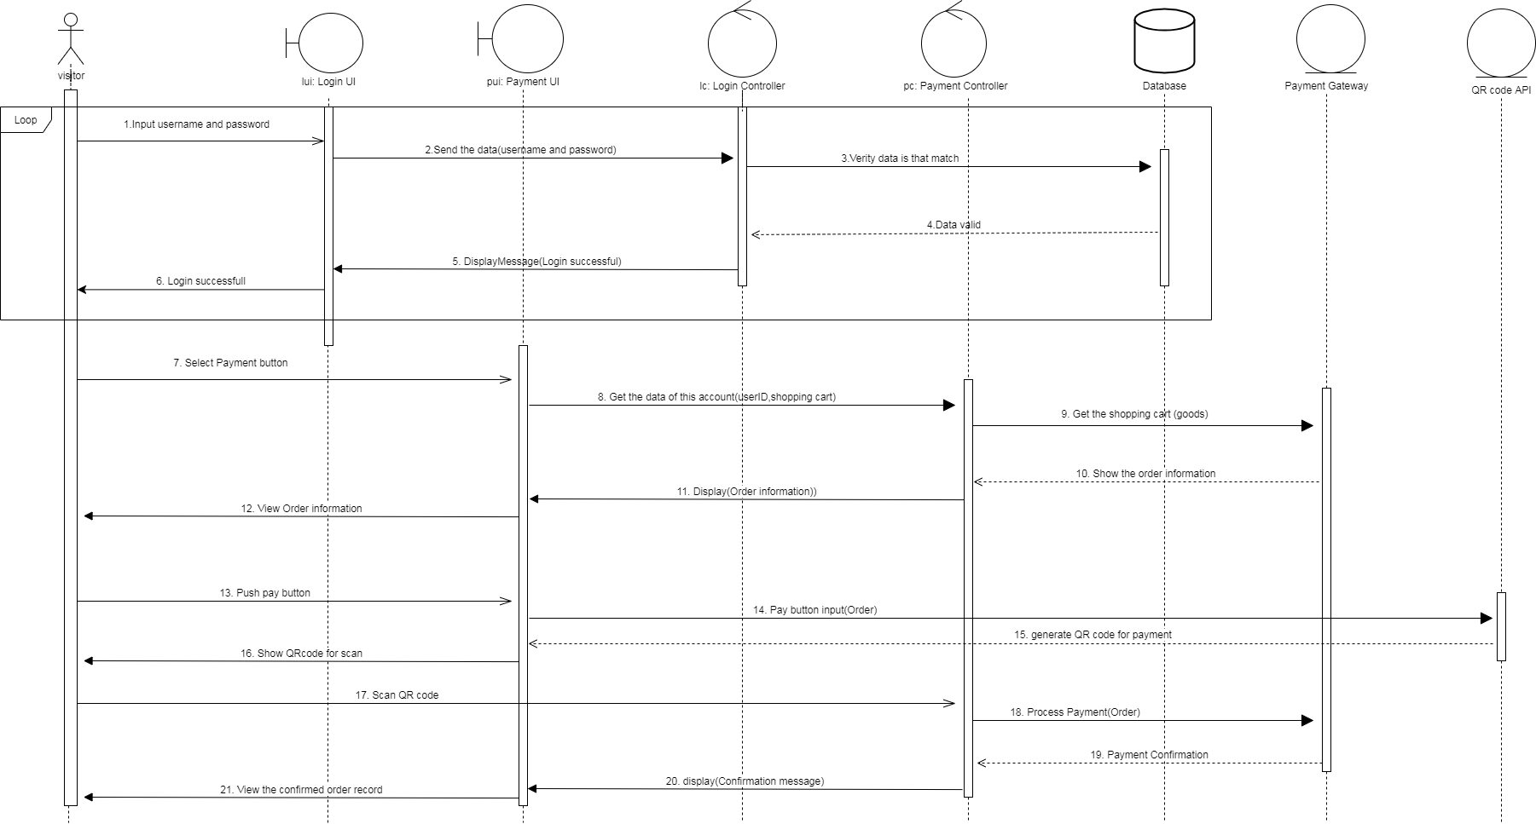
Sequence Diagrams
QR Payment
(Mobile Application)

Slide 14
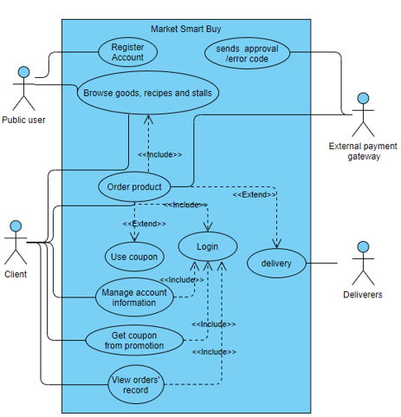
Use case diagrams
Normal User Use Case​

Slide 15
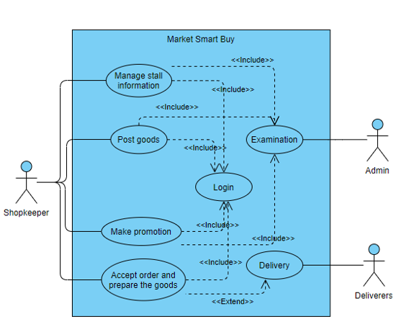
Use case diagram
Shopkeeper Use Case​

Slide 16
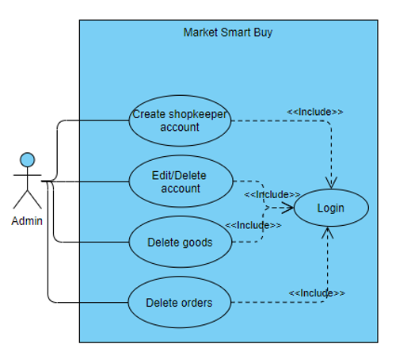
Use case diagram
System Admin Use case​

Slide 17
Conclusion
We hope to make people convenient.
We need time to spread.
We make perfect more of the system.

Slide 18
Thank You!

